Slide 1
Driver drowsiness system

Slide 2
Introduction:
Drowsy driving is one of the major causes behind fatal road accidents. One of the recent study shows that one out of five road accidents are caused by drowsy driving which is roughly around 21% of road accidents, and this percentage is increasing every year as per global status report on road safety, based on the data from 180 different countries. This certainly highlights the fact that across the world the total numbers of road traffic deaths are very high due to driver’s drowsiness. Driver fatigue, drink-and-drive and carelessness are coming forward as major reasons behind such road accidents. Many lives and families are getting affected due to this across various countries. Real time drowsy driving detection is one of the best possible major that can be implemented to assist drivers to make them aware of drowsy driving conditions. Such driver behavioral state detection system can help in catching the driver drowsy conditions early and can possibly avoid mishaps. With this paper, we are presenting technique to detect driver drowsiness using of Open CV, raspberry pi.

Slide 3
Abstract:
Traffic and population is increasing day-by-day in India. Most of the accidents occur due to drowsy driving. Many lives and families are getting affected due to this reason. To overcome these issues we have designed this project. This project works on the main concept of eye blink detection. This project is used to improve safety for the vehicles and reduces road accidents caused due to the driver’s drowsiness.
In this project we are using raspberry pi and webcam. Web cam will continuously capture the driver’s eyes in real time and sends the information to the raspberry pi. Raspberry pi will verify the frames sent from the webcam whether the driver opened or closed his eye. If the driver closes his eyes for the five successive frames it will detects the person is drowsy and sends buzzer indication to alert the driver.

Slide 4
In this Driver Drowsiness System using Image Processing, capturing drivers eye state using computer vision based drowsiness detection systems have been done by analyzing the interval of eye closure and developing an algorithm to detect the driver’s drowsiness in advance and to warn the driver by in vehicles alarm. This section motivates how face is detected and how eye detection is performed for automotive application and their detection is necessary for assessing driver drowsiness.

Slide 5
Literature survey
Ovidiu Stan et.al. Says in the paper “Eye-Gaze Tracking Method Driven by Raspberry PI Applicable in Automotive Traffic Safety” that This paper comes as a response to the fact that, lately, more and more accidents are caused by people who fall asleep at the wheel. Eye tracking is one of the most important aspects in driver assistance systems since human eyes hold much in-formation regarding the driver's state, like attention level, gaze and fatigue level. The number of times the subject blinks will be taken into account for identification of the subject's drowsiness. Also the direction of where the user is looking will be estimated according to the location of the user's eye gaze. The developed algorithm was implemented on a Raspberry Pi board in order to create a portable system. The main determination of this project is to conceive an active eye tracking based system, which focuses on the drowsiness detection amongst fatigue related deficiencies in driving.

Slide 6
Cont…
Kulkarni S. S. et.al. Says in the paper “Application of raspberry pi based embedded system for real time protection against road accidents due to driver’s drowsiness and/or drunk and drive cases” that Present work deals with the application of raspberry pi CPU based sensing system to the detection of driver’s lethargy and alcoholism in order to avoid the road accidents. The embedded system consists of 5 megapixel digital camera, alcohol detection sensor and the buzzer interfaced to the microcontroller. The embedded system is controlled by Raspbian operating system. The system detects real time situation of the driver’s vigilance and control over the vehicle. If alcoholic and / or drowsiness tests are positive, it switches on the alarm, (ii) turn off the vehicle’s engine via microcontroller based program controlling ignition power source and (iii) sends a SMS to the person close to the driver’s location.

Slide 7
Cont…
A. Cheng et. al. described 'Driver Drowsiness Recognition Based on Computer Vision Technology’. They presented a nonintrusive drowsiness recognition method using eye-tracking and image processing. A robust eye detection algorithm is introduced to address the problems caused by changes in illumination and driver posture. Six measures are calculated with percentage of eyelid closure, maximum closure duration, blink frequency, average opening level of the eyes, opening velocity of the eyes, and closing velocity of the eyes. These measures are combined using Fisher’s linear discriminated functions using a stepwise method to reduce the correlations and extract an independent index. Results with six participants in driving simulator experiments demonstrate the feasibility of this video-based drowsiness recognition method that provided 86% accuracy.

Slide 8
Cont…
García et. al. described ‘Driver Monitoring Based on Low-Cost 3-D Sensors’. They proposed a solution for driver monitoring and event detection based on 3-D information from a range camera is presented. The system combines 2-D and 3-D techniques to provide head pose estimation and regions-of-interest identification. Based on the captured cloud of 3-D points from the sensor and analyzing the 2-D projection, the points corresponding to the head are determined and extracted for further analysis. Later, head pose estimation with three degrees of freedom (Euler angles) is estimated based on the iterative closest points algorithm. Finally, relevant regions of the face are identified and used for further analysis, e.g., event detection and behavior analysis. The resulting application is a 3-D driver monitoring system based on low-cost sensors. It represents an interesting tool for human factor research studies, allowing automatic study of specific factors and the detection of special event related to the driver, e.g., driver drowsiness, inattention, or head pose.

Slide 9
Cont…
Eyosiyas et. al. described ‘Driver Drowsiness Detection through \HMM based Dynamic Modeling’. They proposed a new method of analyzing the facial expression of the driver through Hidden Markov Model (HMM) based dynamic modeling to detect drowsiness. They have implemented the algorithm using a simulated driving setup. Experimental results verified the effectiveness of the proposed method.

Slide 10
Existing System
In existing we are using eye blink sensor to detect the drowsiness of the person. It looks like normal spectacles attached with a sensor. The sensor emits infrared rays. If the sensor detect it is the sign of drowsiness so we can alert the driver by using Buzzer.
Drawbacks:
Long exposure to the IR rays is injuries to eyes.
People who have eye sight cannot wear the spectacles as this spectacles don’t work as vision spectacles.
This sensor is in the middle of the spectacles so that the driver’s driving may be difficult.

Slide 11
Proposed System:
In this project we are using raspberry pi and webcam. Web cam will continuously capture the driver’s eyes in real time and sends the information to the raspberry pi. Raspberry pi will verify the frames sent from the webcam whether the driver opened or closed his eye. If the driver closes his eyes it will detects the person is drowsy and sends buzzer indication to alert the driver.

Slide 12
Block Diagram
camera
Raspberry pi
Buzzer

Slide 13
Hardware Requirements

Slide 14
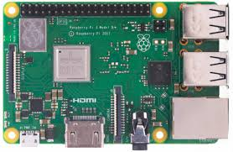
Raspberry Pi
Raspberry PI 3 It is a sort of development board which has the modules like WIFI and Bluetooth comes on board, we can connect any form of sensors to raspberry pi3 through the GPIO pins. it has forty GPIO pins 4 USB ports ,1 LAN port ,1 port for electricity supply and it has on board provided with 1gb RAM

Slide 15
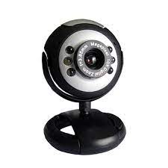
Web Camera
A webcam is a small digital video camera directly or indirectly connected to a computer or a computer network.
Webcams come with software that needs to be installed on the computer to help users record video on or stream it from the Web. Webcams are capable of taking pictures as well as high-definition videos, although the video quality can be lower compared to other camera models.

Slide 16
Software Requirements

Slide 17
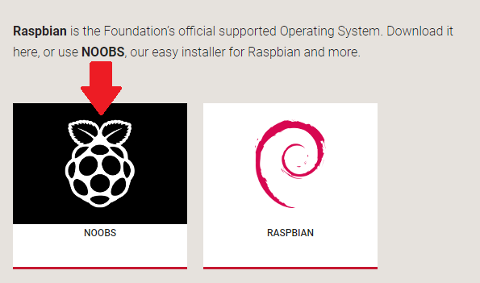
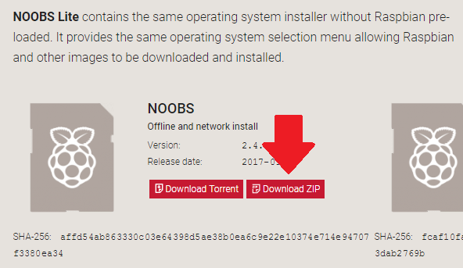
Downloading Noobs

Slide 18
Set up your SD card
Format the SD card using SD Formatter 4.0
Download NOOBS
Extract NOOBS from the zip archive
Copy all the files to SD card

Slide 19
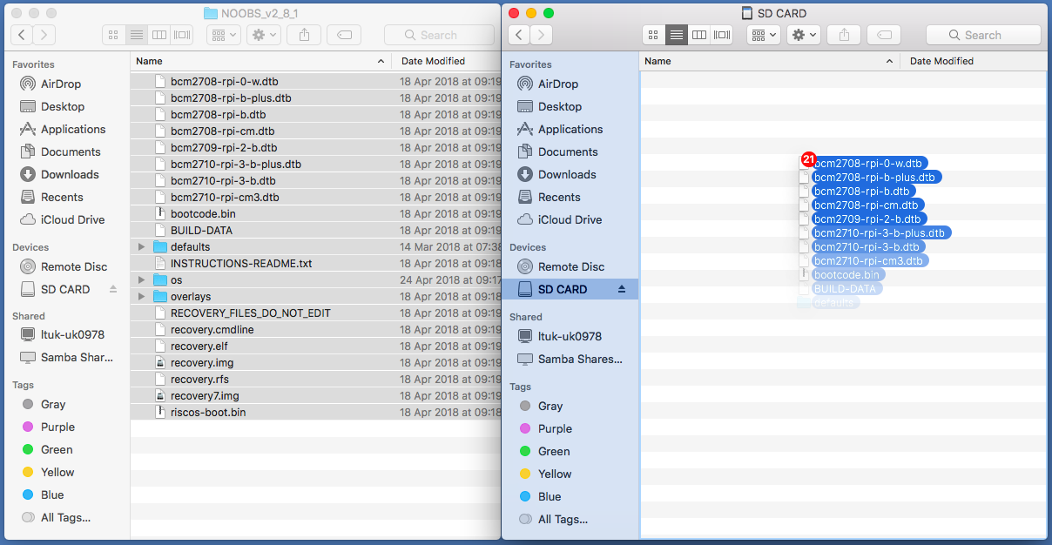
Copying Noobs to Formatted SD Card

Slide 20
Noobs installation After Inserting SD card in Raspberry Pi

Slide 21
Raspberry pi setup

Slide 22
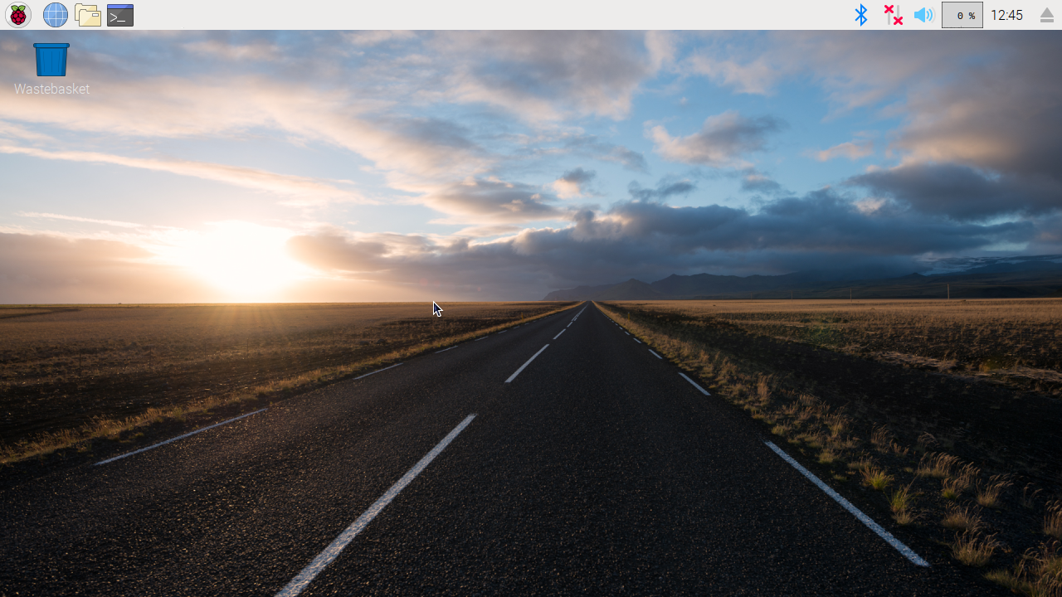
Raspberry Pi Desktop

Slide 23
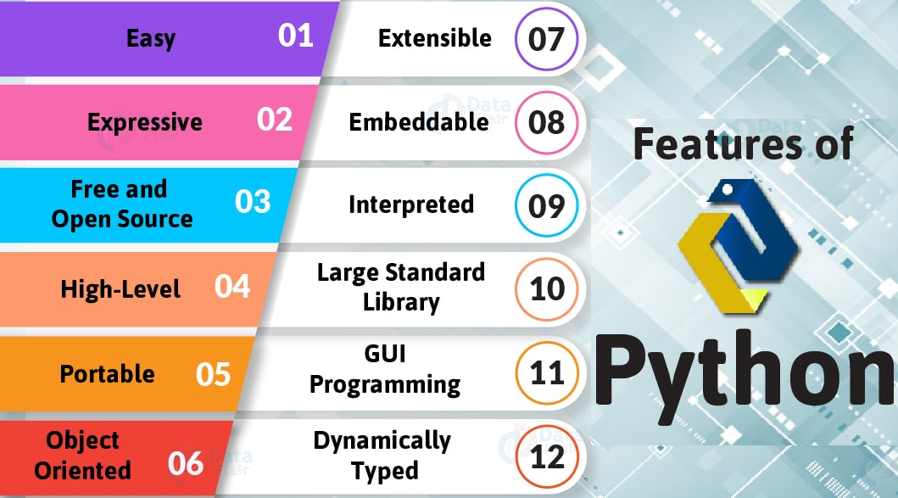
Features of python

Slide 24
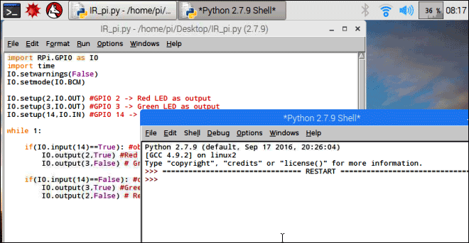
Python IDE

Slide 25
Applications:
Vehicles
Advantages:
Reduces accidents
Saves lives

Slide 26
Conclusion
The Drowsiness Detection System developed based on eye closure of the driver can differentiate normal eye blink and drowsiness and detect the drowsiness while driving. The proposed system can prevent the accidents due to the sleepiness while driving. The system works well even in case of drivers wearing spectacles and even under low light conditions if the camera delivers better output. Information about the head and eyes position is obtained through various self-developed. During the monitoring, the system is able to decide if the eyes are opened or closed. When the eyes have been closed for too long, a warning signal is issued.

Slide 27
References
Eyosiyas Tadesse, Weihua Sheng, Meiqin Liu,” Driver Drowsiness Detection through HMM based Dynamic Modeling.” 2014 IEEE International Conference on Robotics & Automation (ICRA) Hong Kong Convention and Exhibition Center May 31 - June 7, 2014. Hong Kong, China.
Zhang, Wei; Cheng, Bo; Lin, Yingzi,” Driver drowsiness recognition based on computer vision technology.” Published in: Tsinghua Science and Technology (Volume: 17, Issue: 3) Page(s):354 - 362 Date of Publication: June 2012.
Gustavo A. Peláez C., Fernando García, Arturo de la Escalera, and José María Armingol,” Driver Monitoring Based on Low-Cost 3-D Sensors.” IEEE TRANSACTIONS ON INTELLIGENT TRANSPORTATION SYSTEMS, VOL. 15, NO. 4, Page(s): 1855 - 1860 AUGUST 2014.
T. Soukupova and J. Cech, "Real-time eye blink detection using facial landmarks," in 21st Computer Vision Winter Workshop (CVWW’2016), 2016, pp. 1-8.
“Tutorial: How to send an email with Python,” Nael Shiab, 03-Oct-2015. [Online]. Available: http://naelshiab.com/tutorial-send-email-python/. [Accessed: 29-Nov-2017] .
“Average duration of a single eye blink - Human Homo sapiens - BNID 100706,” Bionumbers- The Database for Useful Biological Numbers. [Online]. Available: http://bionumbers.hms.harvard.edu/bionumber.aspx?s=y&id=100706&v er=0. [Accessed: 07-May-2018].
“Drowsy Driving,” National Highway Traffic Safety Administration (NHTSA), 01-Feb-2018. [Online]. Available: https://www.nhtsa.gov/risky-driving/drowsy-driving. [Accessed: 11- Apr-2018].

